Slide 1

PRIORITY RISK IDENTIFICATION AND SCOPE MEASUREMENT
Team Members:
Yuthika Shekhar
Abhijeet Talaulikar
Sajid Hussain Rafi Ahamad
Hailey Thanki
Siddharth Susarla
Mentor:
Cantay Caliskan

Slide 2



Objective
Review of Previous Presentation
Current Progress
Next steps

Slide 3
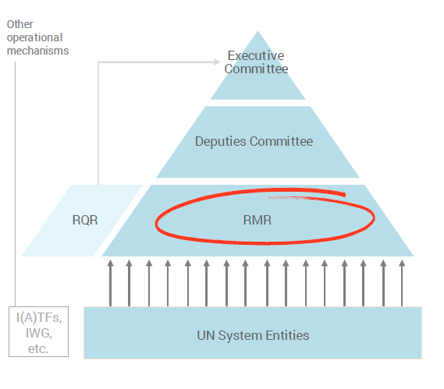
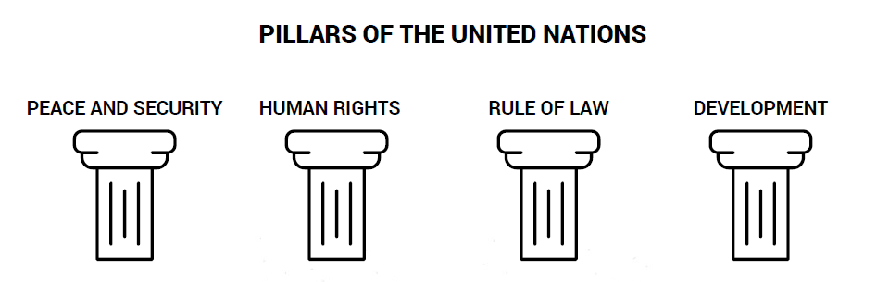
United Nations Overview
The United Nations is an international organization-193 Member States.
Notes:
Purpose: maintain international peace and security, develop friendly relations among nations, achieve international cooperation, and be a centre for harmonizing the actions of nations.
The UN Secretary General, General Assembly and Security Council have most of the control over the United Nations.
RMR: Regional Monthly Review
Systematic Risk focused country scanning
Deputy: Monthly “horizon scanning” of issues requiring the SG’sand Principals attention
Monthly prevention discussion,focusing onissues elevated by theRMR process
Executive Committee:
Issuesand situations requiring highest-level engagement and/ormajorcourse-correction

Slide 4
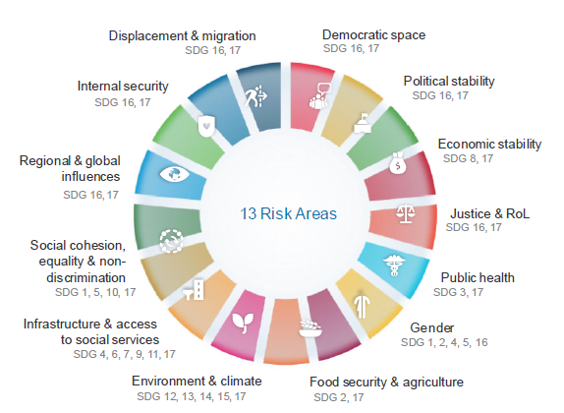


Problem Statement Review
Problem Statement 1: Which survey variable is the best predictor of priority risks out of the 13?
Problem Statement 2: Which survey variable is the best predictor of UN action urgency and extent

Slide 5
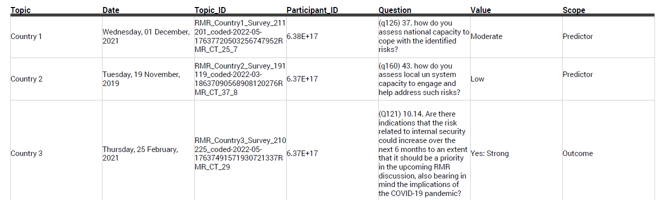
Overview of Survey Data
63 surveys across three years (2019 to 2021) and covering 53 countries around the world
16K rows

Slide 6
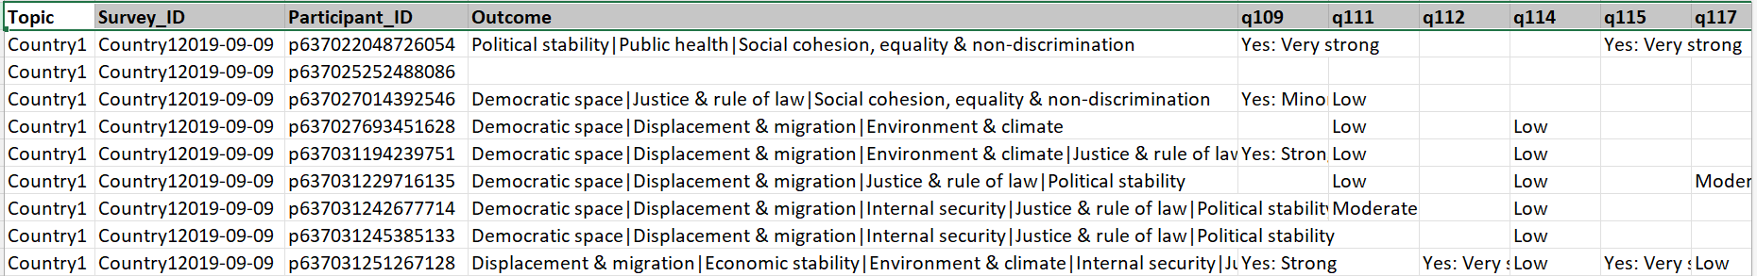
Pivoted Survey Data
Treat every survey + participant combination as a row.
Each row can be interpreted as an opinion of a participant in a specific survey about a country.
Columns = maximum number of questions per survey

Slide 7
Descriptive Analysis
Survey responses starting 2019 to 2021
85% of the countries only had a single survey.

Slide 8
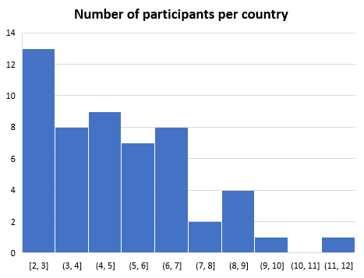
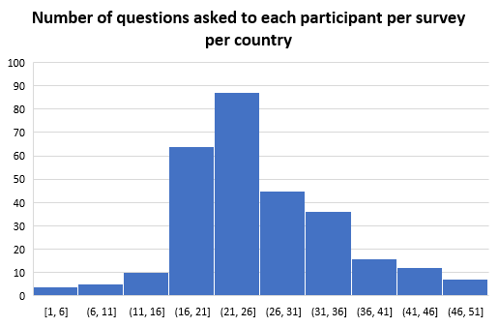
Descriptive Analysis
About 13 countries had just 2 to 3 participants take the survey. Possible reason – smaller countries?
On an average, participants were asked between 20 to 25 questions in a survey

Slide 9
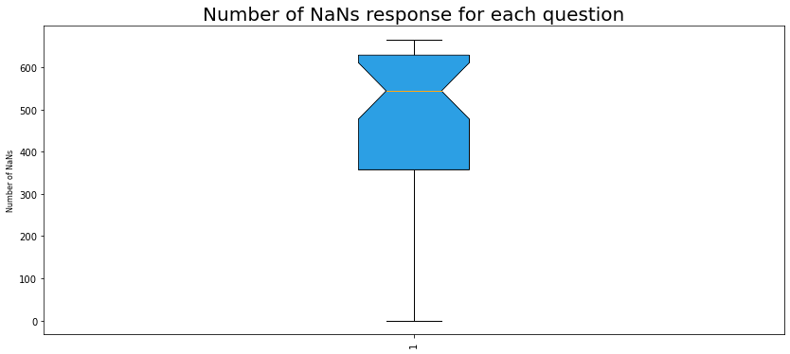
Challenges
Distribution of missing values per survey question
As seen in box plot, sparsity is typically the biggest challenge when working with Survey data.

Slide 10
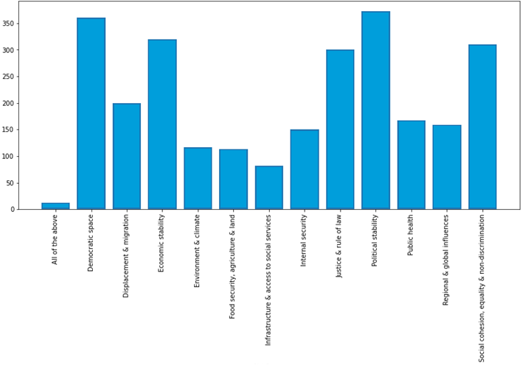
Distribution of Risk Factors
Most common Political Stability, Democratic Space, Economic Stability
Least common Infrastructure, Environment, Food security

Slide 11
Risks and Facts
31% Priority risk - Food Security Impending risk - Economic Stability
27% Priority risk - Democratic Space Impending risk - Political Stability
27% Priority risk - Social Cohesion Impending risk - Political Stability
25% Priority risk - Social Cohesion Impending risk - Democratic Space
23% Priority risk - Social Cohesion Impending risk - Justice & Rule of Law
When economic stability, political stability, democratic space or justice are an identified risk, 30% of the participants thought the UN engagement needed a significant change over coming months.

Slide 12
Scope
Roll up individual questions to category and check correlation with priority risks.
Obtain additional data – more surveys and more participants.
Create interactive dashboard for visualizing question-outcome correlations.
Kickstart Problem Statement 2.

Slide 13
Thank You

